Slide 1
NIOS Processor Stack and Function Calls
Engineering 304 Lab

Slide 2
Data Element Sizes in Memory
NIOS processors use byte-addressable memory
Byte = 8 bits (ldb, stb)
Requires one address location
Half word = 16 bits = 2 bytes (ldh, sth)
Requires two address locations – referenced by an even-numbered address
Word = 32 bits = 4 bytes (ldw, stw)
Requires four address locations – referenced by an address which is a multiple of four

Slide 3
Big vs Little Endian
Example: Storing 0x12345678 into address 0x2134
Motorola/Freescale: big endian; Intel: little endian
NIOS is little endian
0x12_34_56_78
Big Endian
Little Endian
Addr Data
Addr Data
0x2134
0x2135
0x2136
0x2137
0x12
0x2134
0x2135
0x2136
0x2137
0x78
0x34
0x56
0x56
0x34
0x78
0x12

Slide 4


Big vs Little Endian
Example: Storing 0x12345678 into address 0x2134
NIOS is little endian (compare byte vs word)
0x12_34_56_78
Big Endian
Little Endian
Addr Data
Addr Data
0x2134
0x2135
0x2136
0x2137
0x12
0x2134
0x2135
0x2136
0x2137
0x78
0x34
0x56
0x56
0x34
0x78
0x12

Slide 5
Procedural Programming
Code is broken down into functions (procedures)
Each function executes a specific operation
Arguments are passed to the function
The calculation is completed
A return value is sent back to the calling function
Actual value returned or an error number (0=success, others are error codes)

Slide 6
Review Recursion
Recursion is when one function calls itself
The function must clearly define a recursion stopping point
Same instructions in memory are repeatedly executed (must manage the data well!)
Factorial calculation example

Slide 7
Registers used for function calls
Arguments 1-4 are placed in r4, r5, r6, & r7 in that order as needed
Return values 1 and 2 are placed in R2 & R3 in that order as needed
C-code Example
Z = my_Function(A, B, C);
Steps:
A is placed in r4, B in r5, and C in r6
The assembly instruction “call my_Function” is then used
{my_Function does its work and then puts the value of Z in r2 and then uses the “ret” instruction}
The calling function finds Z in r2

Slide 8
Function Call Registers (cont)
Stack Pointer (sp)
Always points to the last used entry in the stack
Should be initialized to the address of the last byte in memory + 1
E.g. memory from 0x1000 – 0x17ff, then SP initialized to 0x17ff+1 = 0x1800
Return Address (ra)
Holds the address of the instruction immediately after the “call” instruction when the “call” is executed (“breadcrumb”)
Used by the “ret” instruction to return to the calling function’s instruction immediately after the “call”

Slide 9
Pushes and Pops (stack)
Push = the placing of an item on a stack
E.g. adding napkins to a spring-loaded napkin dispenser
Pop = the taking of an item off a stack
E.g. removing a napkin from a spring-loaded dispenser
On NIOS, all pushes and pops are memory ⬄ registers (ldw/stw) and are of size=word (4 bytes)
Stack Pointer points at last used stack entry and must be adjusted for each push/pop

Slide 10
Pushing and Popping on NIOS
1-element Push: 1-element Pop:
addi sp, sp, -4 ldw rX, 0(sp)
stw rX, 0(sp) addi sp, sp, 4
2-element Push: 2-element Pop:
addi sp, sp, -8 ldw rY, 0(sp)
stw rX, 4(sp) ldw rX, 4(sp)
stw rY, 0(sp) addi sp, sp, 8

Slide 11
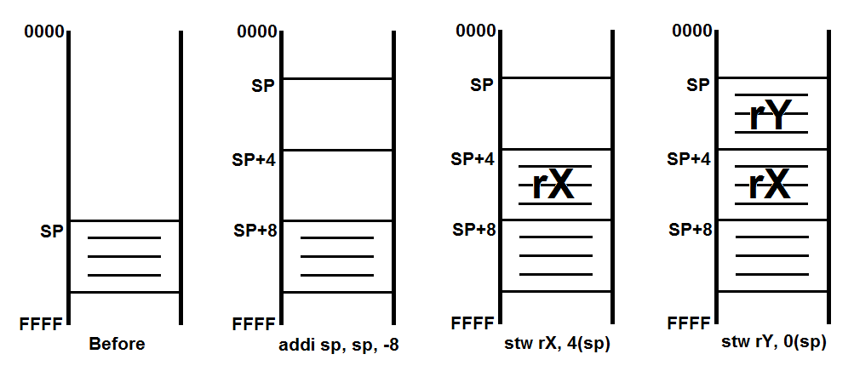
Before Performing 2 Pushes

Slide 12
Push: After Adjusting the Stack Pointer

Slide 13
Push: After Saving rX

Slide 14
Push: After Saving rY

Slide 15
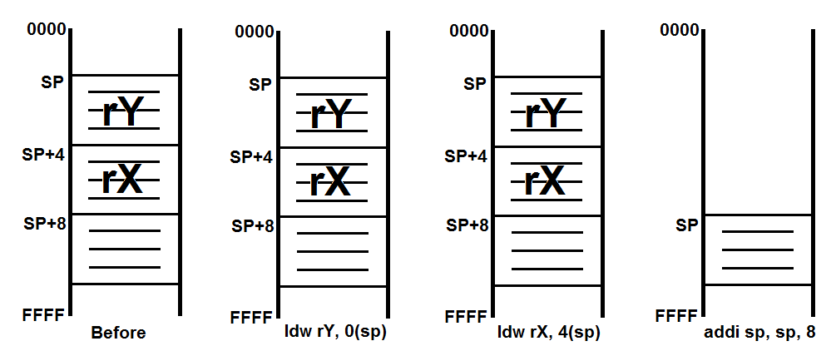
Before Performing 2 Pops

Slide 16
Pop: After Reading rY from Stack

Slide 17
Pop: After Reading rX from Stack

Slide 18
Pop: After Adjusting the Stack Pointer

Slide 19
Function Calls
The following describes the standard assembly program structure for making function calls, saving registers, and restoring registers. Actions to perform at various points in the program are shown in {}s.
Calling a subfunction uses the “call label” instruction (label = name of subfunction)
To return to the calling function, use the “ret” instruction at the end of the subfunction

Slide 20
_start function
_start:
{setup stack pointer to the highest memory address +1}
…
Pre_call:
{Push caller-saved registers}
call Sub1
Post_call:
{reverse-pop caller-saved registers}
…
End_start:
br End_start /* infinite loop here */

Slide 21
Subfunction (includes “main()”)
Sub1:
Prologue:
{Push ra, callee-saved registers}
…
Pre_call:
{Push caller-saved registers}
call Subfunction
Post_call:
{reverse-pop caller-saved registers}
…
Epilogue:
{reverse-pop callee-saved registers, ra}
End_Sub1:
ret

Slide 22
Leaf Routine (calls no other fcn)
SubLeaf:
/* no pushing or popping needed unless using callee-saved registers */
…
End_SubLeaf:
ret

Slide 23
Recommended Approach
Ignore push/pop requirements and create code for each function, properly using the registers r4-r7 and r2-r3
Identify all pre-call, post-call, prologue, and epilogues spots
Add comments to list what is pushed/popped
Add the necessary instructions to do the push and pop operations identified

